Slide 1
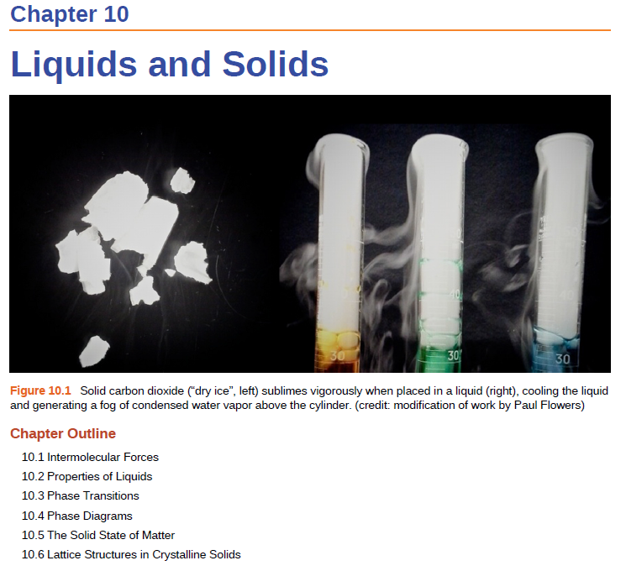

Slide 2
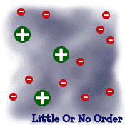
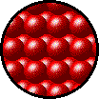
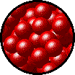
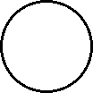
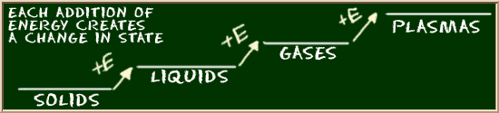
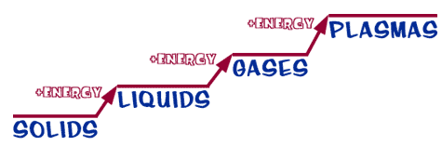
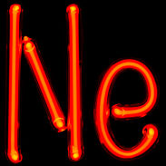
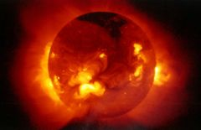
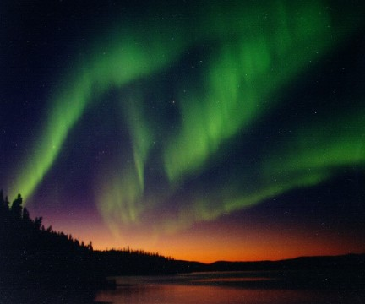
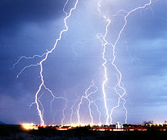

STATES OF MATTER
Plasma- Electrically charged particles in a gaseous state.
We will focus on solids, liquids and gasses.

Slide 3
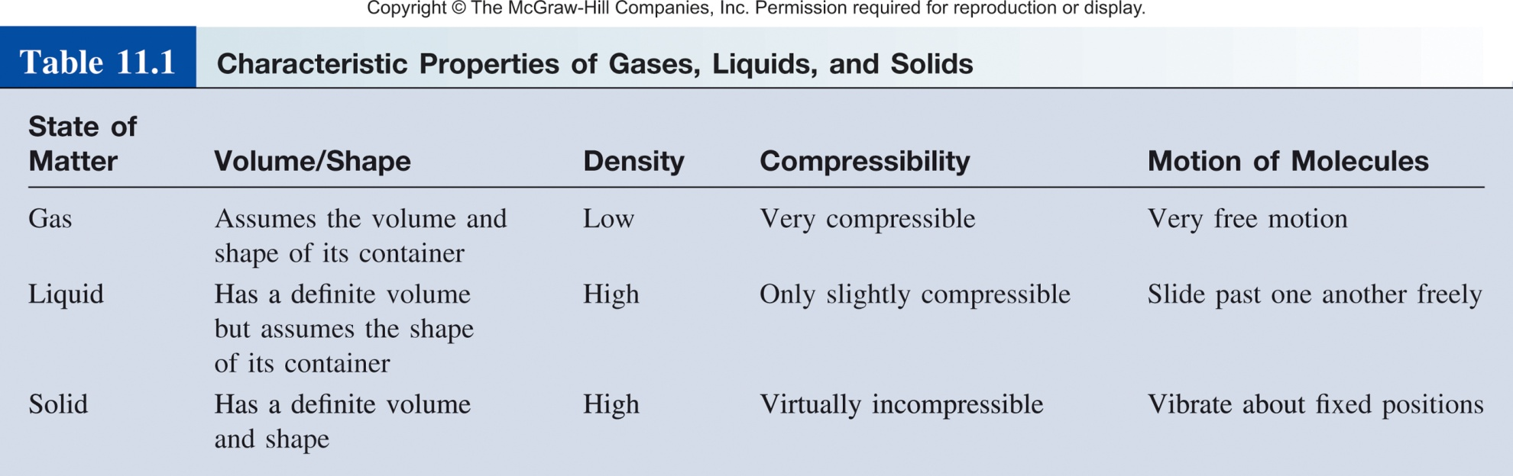
States of Matter

Slide 4
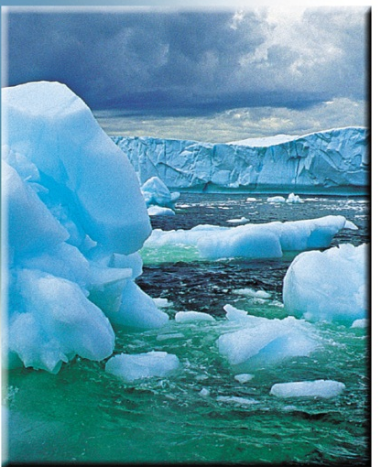
States of Matter
H₂O
Solid - ice
Liquid - water
Gas - humidity
A phase is
- a homogeneous part of the system in contact with other parts of the system but separated from them by a “well-defined” boundary.
  - has a distinct set of physical properties.

Slide 5
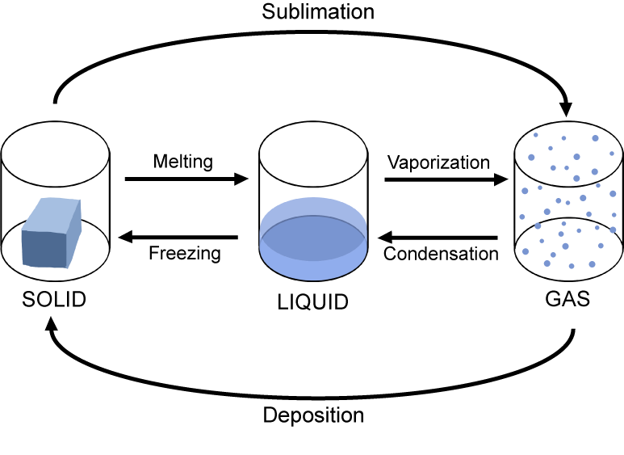
States of Matter
We call the transitions between different states of matter phase changes
What dictates the current state of the system?
or
Why is there a change between states?

Slide 6
Phase Changes
heat is released
condensation
freezing
gas
liquid
solid
cool
cool
heat
heat
evaporation
melting
increasing temperature
heat is absorbed
Energy needed to break intermolecular interactions.

Slide 7
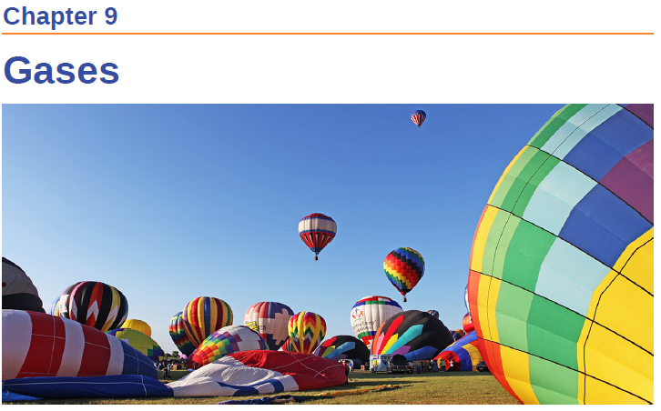
Ideal Gas Equation
PV = nRT
P = pressure
V = volume
n = number of moles
R = gas constant
T = temperature
Assumptions:
Gas atoms/molecules are perfect spheres (spherical cow!)
Size of atoms/molecules are negligibly small
There are no intermolecular/atom forces
Ok assumptions for gasses, does not work for solids and liquids.

Slide 8
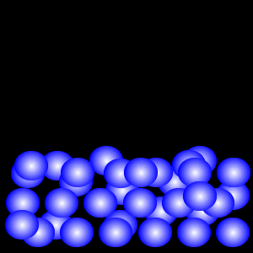
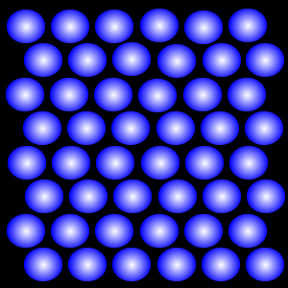
Liquids and Solids
Not all solids and liquids are equal:
  Viscosity, conductivity, surface tension, volume, density, melting point, boiling point, hardness, color, flexibility, cost
Variables:
  Size and shape of the molecules/atoms
  The intermolecular forces

Slide 9
Intramoelcular vs Intermolecular
Intramolecular forces
  exist within each molecule
  influence the chemical properties of the molecule
  ionic, covalent, and metallic bonds
Intermolecular forces
  exist between independent molecules/atoms
  influence the physical properties of the substance
  Responsible for the state of the system:
  gas, liquid, solid.

Slide 10
Intramolecular vs. Intermolecular Forces
Intramolecular forces:
  Ionic bonds (400-4000 kJ/mol)
  Covalent bonds (150-1100 kJ/mol)
  Metallic bonds (75-1000 kJ/mol)
Intermolecular forces:
  0.05-100 kJ/mol
  much weaker
Example
930 kJ to break all O-H bonds in 1 mole of water (intra)
41 kJ to vaporize 1 mole of water (inter)

Slide 11
Liquids and Solid
Why do some solids dissolve in water but others do not?
Why are some substances gases at room temperature, but others are liquid or solid?
What gives metals the ability to conduct electricity, what makes non-metals brittle?
Intermolecular forces!

Slide 12
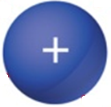
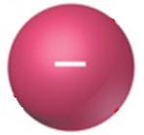

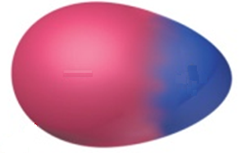


Flavors of Intermolecular Forces
Ions
Polar Molecules
Nonpolar Molecules/Atoms
ion-dipole
dipole-dipole
hydrogen bonding
Induced/instantaneous dipole:
  ion-induced dipole
  dipole-induced dipole
  instantaneous dipole-induced dipole (dispersion forces)

Slide 13
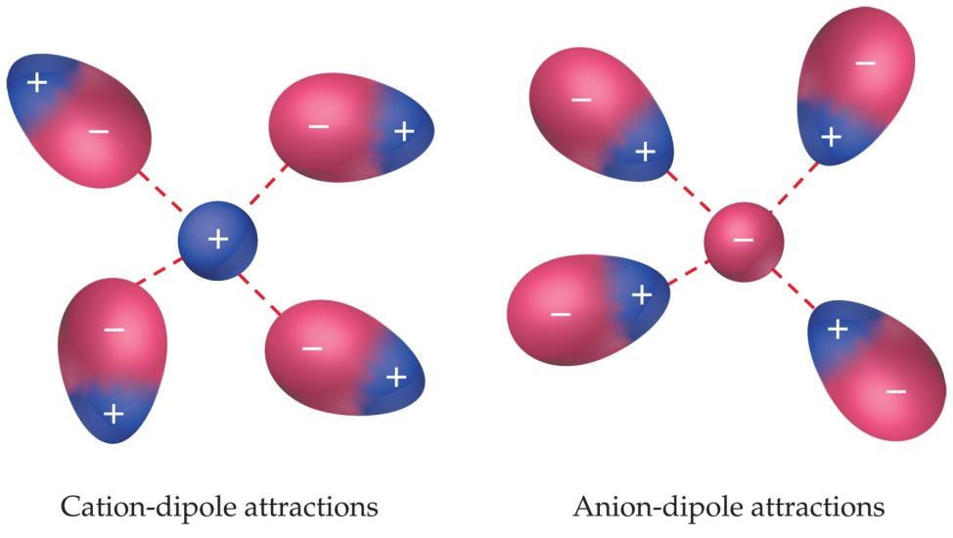
Ion-Dipole Forces
Ion
Dipole (polar)
The ion is attracted to the opposite charge on the polar molecule.

Slide 14
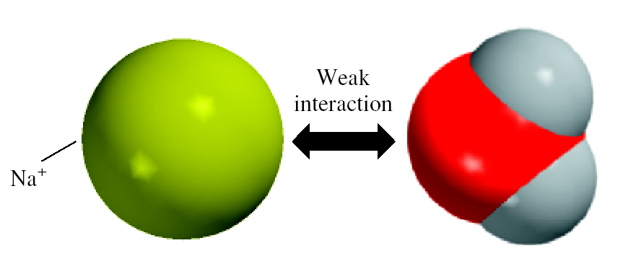
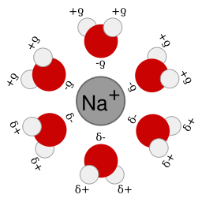
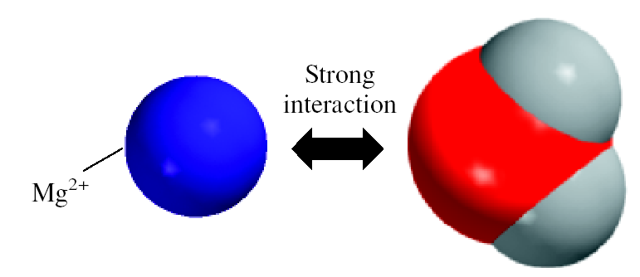
Ion-Dipole Forces
Why ionic compounds (NaCl, DNA, etc.) dissolves in water.
Typical energy range: 40-600 kJ/mol.
Dependent on: ion size/charge and dipole strength

Slide 15

Flavors of Intermolecular Forces
Ions
Polar Molecules
Nonpolar Molecules/Atoms
ion-dipole
dipole-dipole
hydrogen bonding
Induced/instantaneous dipole:
  ion-induced dipole
  dipole-induced dipole
  instantaneous dipole-induced dipole (dispersion forces)

Slide 16
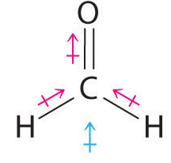
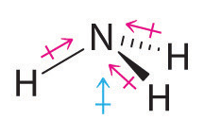
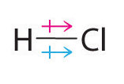
Dipole-Dipole Forces
Molecular dipole-neutral molecule with a positive and negative electron distribution.
Bond Dipole
Molecular Dipole
Molecules that have permanent dipoles are attracted to each other via dipole-dipole interactions.
  The positive end of one is attracted to the negative end of the other and vice-versa. Larger dipole = stronger attraction.

Slide 17
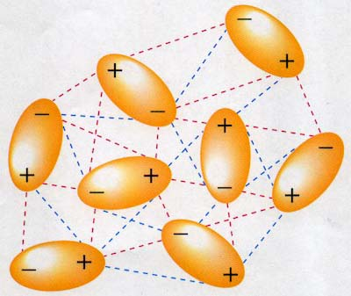
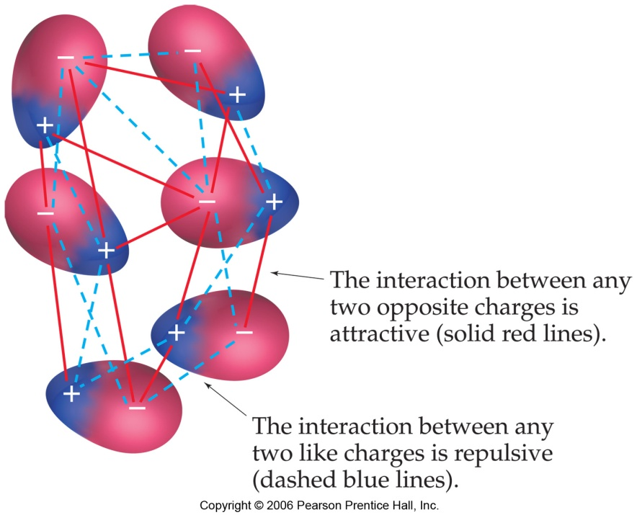
Dipole-Dipole Forces
In solution:
Both attractive and repulsive forces.
Typical energy range: 5-25 kJ/mol.

Slide 18
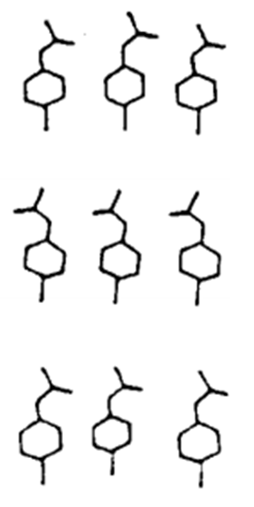
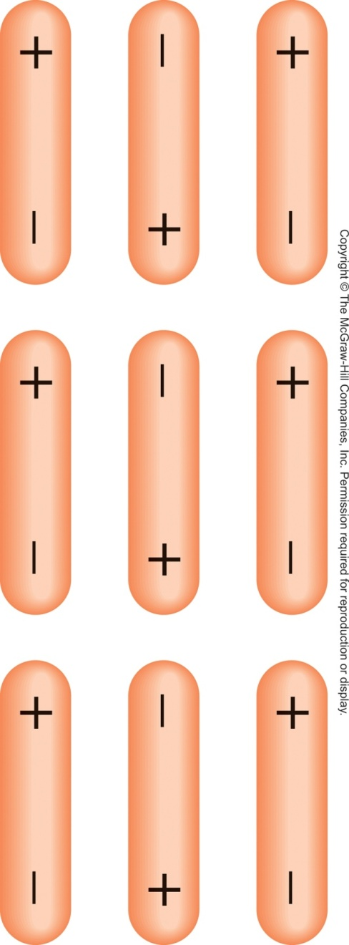
Dipole-Dipole Forces
In solids:
p-chloroacetanilide-
Pyroelectricity
Piezoelectricity
All dipoles cancel.
Dipoles sum.

Slide 19
Flavors of Intermolecular Forces
Ions
Polar Molecules
Nonpolar Molecules/Atoms
ion-dipole
dipole-dipole
hydrogen bonding
Induced/instantaneous dipole:
  ion-induced dipole
  dipole-induced dipole
  instantaneous dipole-induced dipole (dispersion forces)

Slide 20
Hydrogen Bonding
Increase in dipole-dipole
Decreasing boiling point

Slide 21

Hydrogen Bonding
Increase in dipole-dipole
Decreasing boiling point
Not just dipole-dipole but also something else!

Slide 22
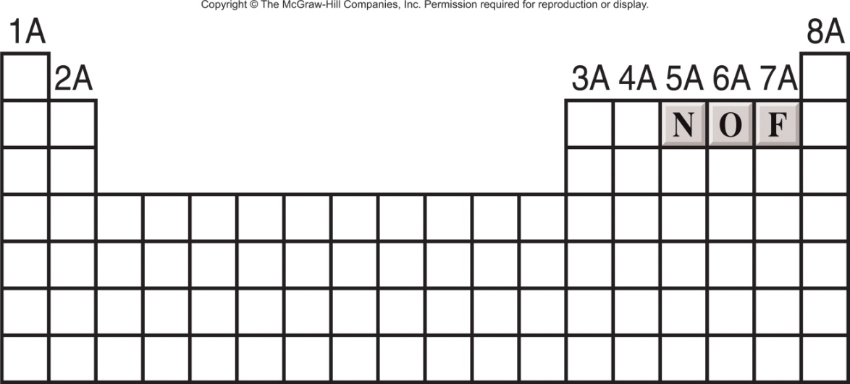
Hydrogen Bonding
A hydrogen bond is a special dipole-dipole interaction between the hydrogen atom in a polar N-H, O-H, or F-H bond and a lone pair on O, N, or F atom.
X
H
…
X
or
X
H
…
X
Where X is N, O, or F
Typical energy:
10-40 kJ/mol.
Hydrogen bonding molecules have:
        A strong permanent dipole
        (electronegative elements like N, F, O)
        A hydrogen atom
        An N, F, or O atom with lone pair electrons

Slide 23
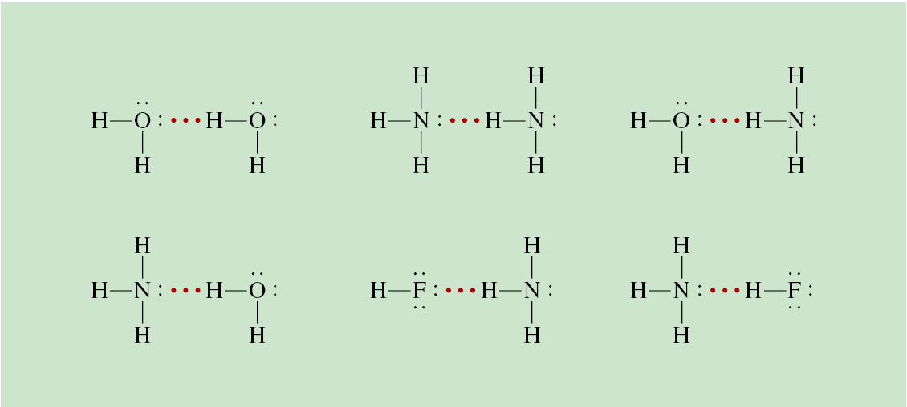
Hydrogen Bonding
These are forces between polar molecules that contain an H atom bonded to a small, highly electronegative atom (N, O, F) with lone electron pair(s)
N(CH₃)₃
N(CH₃)₄⁺
Can Hydrogen bond
Cannot Hydrogen bond

Slide 24
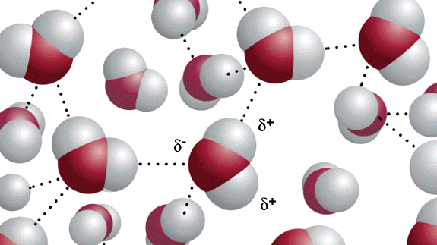
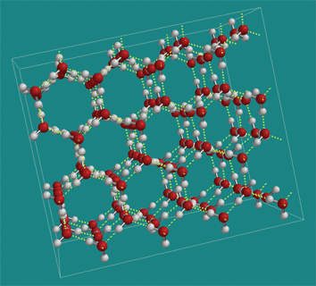
Hydrogen Bonding in H₂O
Liquid
(water)
Solid
(ice)

Slide 25
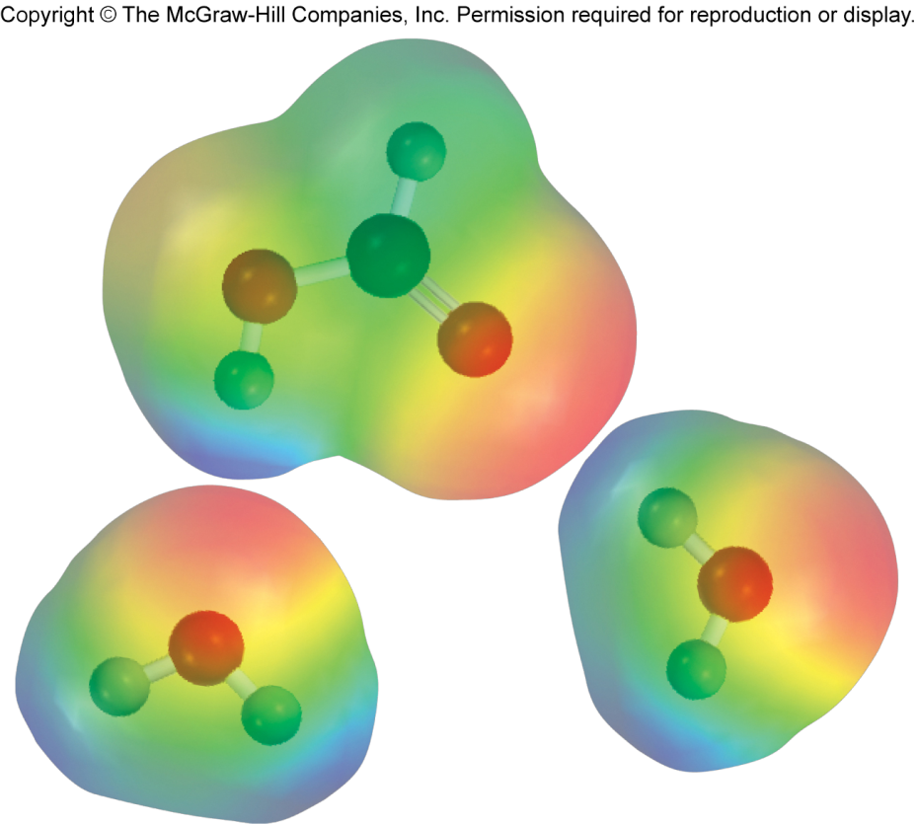
Hydrogen Bonding
Note: that some molecules like HCOOH (formic acid) and others can form hydrogen bonds in multiple ways.

Slide 26
Which of the following can form hydrogen bonds with water?
A) CH₃OCH₃
B) CH₄
C) SF₂
D) HCOOH
E) Na⁺

Slide 27
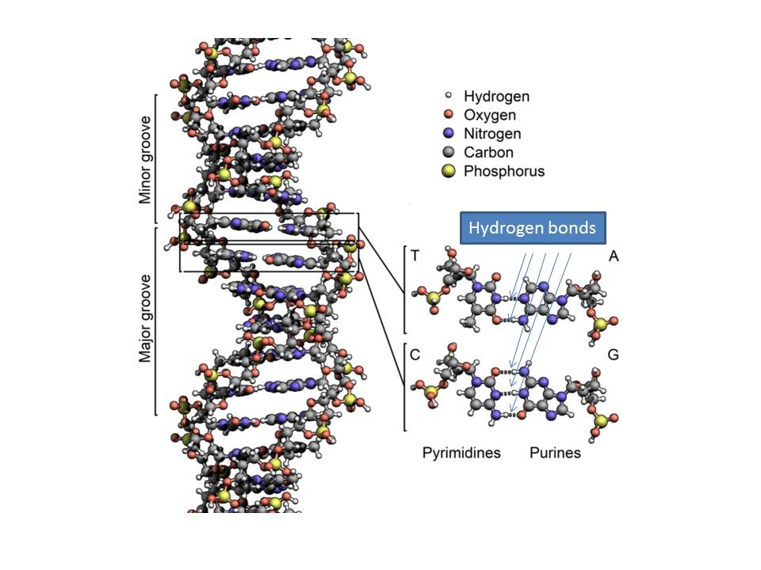
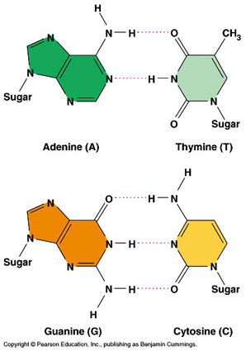
Why does hydrogen bonding matter?
Strong enough to hold a helix!
Weak enough for replication!

Slide 28
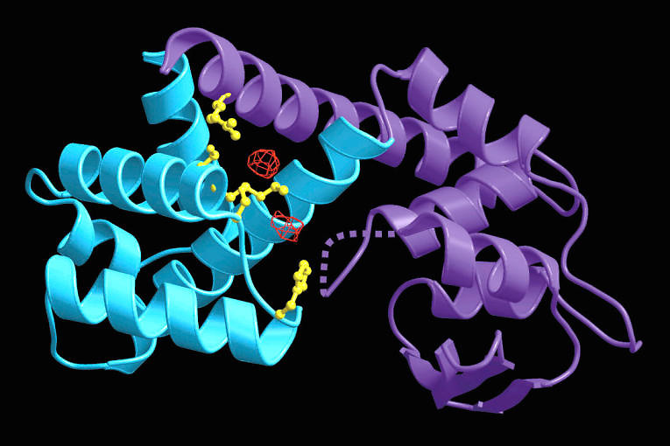
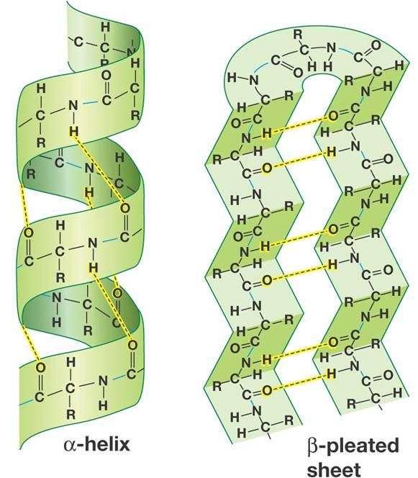
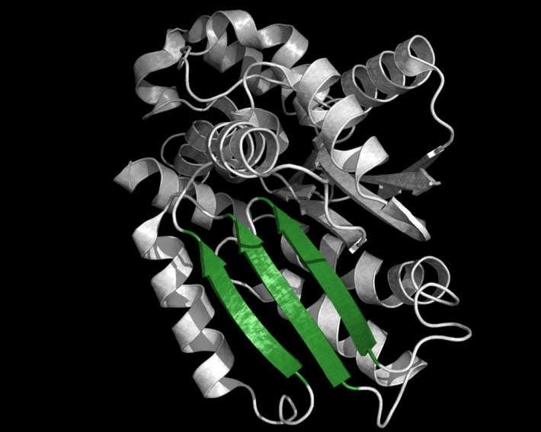
Why does hydrogen bonding matter?
Protein Structure

Slide 29
Flavors of Intermolecular Forces
Ions
Polar Molecules
Nonpolar Molecules/Atoms
ion-dipole
dipole-dipole
hydrogen bonding
Induced/instantaneous dipole:
  ion-induced dipole
  dipole-induced dipole
  instantaneous dipole-induced dipole (dispersion forces)

Slide 30
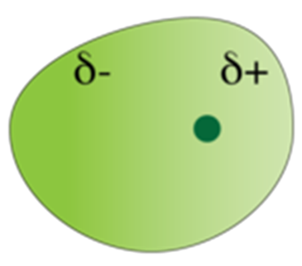
Instantaneous or Induced Dipole
Fluctuations of electron density create an instantaneous dipole (or induced dipole) at an arbitrary moment in time.
non-polar
molecule/atom
instantaneous dipole
or
induced dipole
This property of the electron cloud to be distorted is called polarizability

Slide 31
Polarizability Trends
Polarization
Polarizability increases down the table:
  bigger electron cloud = easier to distort
Polarizability decreases from left to right across the table
  more positive nuclear charge = less flexible electron cloud

Slide 32
Non-polar Molecules
non-polar
molecule/atom
instantaneous dipole
and/or
induced dipole
Non-polar Intermolecular Interactions:
  ion-induced dipole
  dipole-induced dipole
  instantaneous dipole-induced dipole

Slide 33

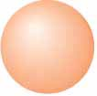

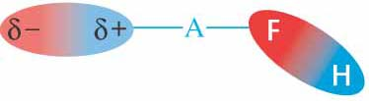
Induced Dipole Forces
Ion-induced dipole: 3-15 kJ/mol
Dipole-induced dipole: 2-10 kJ/mol
+ cation
+ anion
Neutral atom

Slide 34
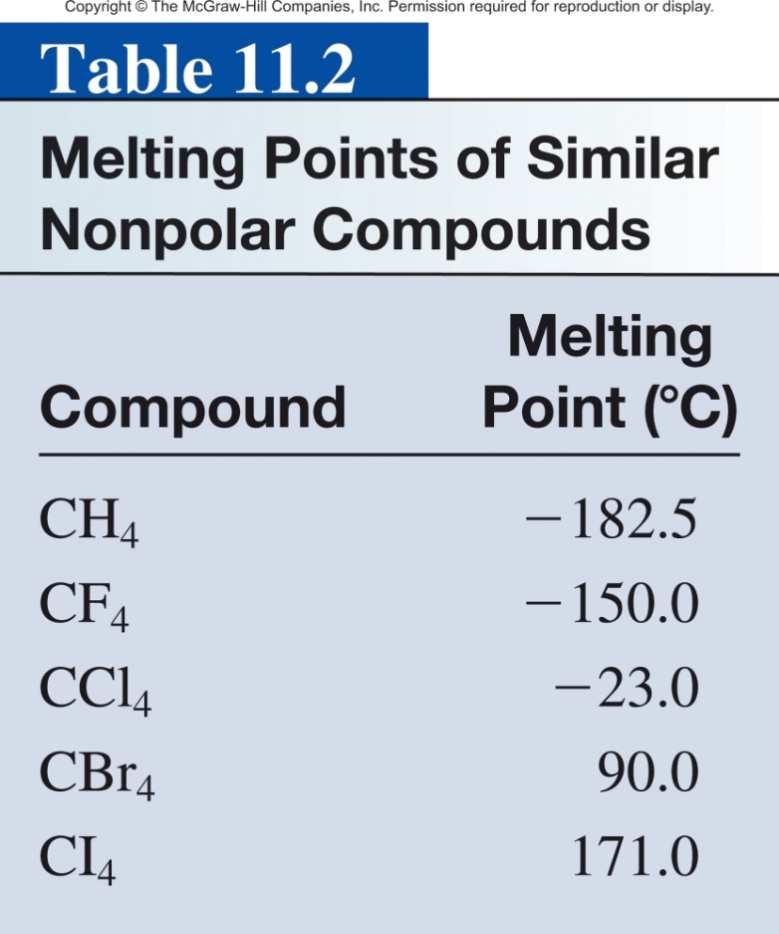
Instantaneous dipole-induced dipole
Dispersion forces usually increase with molar mass.
instantaneous dipole
induced dipole
Interaction between non-polar atoms and/or molecules.
0.05-40 kJ/mol

Slide 35
Size Matters
Hydrocarbon = carbon + hydrogen = non-polar molecules

Slide 36

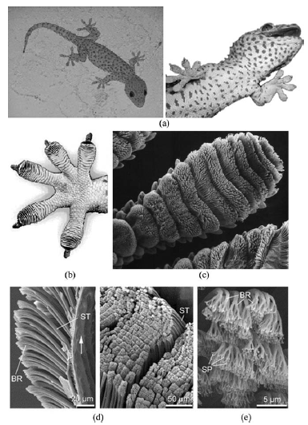
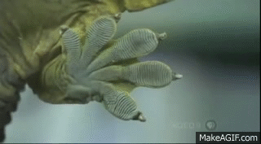
Gecko Wall Walking
Intermolecular interaction:
  dipole-dipole
  dipole-induced dipole
  Instantaneous dipole-induced dipole

Slide 37
Flavors of Intermolecular Forces
Ions
Polar Molecules
Nonpolar Molecules/Atoms
ion-dipole
dipole-dipole
hydrogen bonding
Induced/instantaneous dipole:
  ion-induced dipole
  dipole-induced dipole
  instantaneous dipole-induced dipole (dispersion forces)

Slide 38
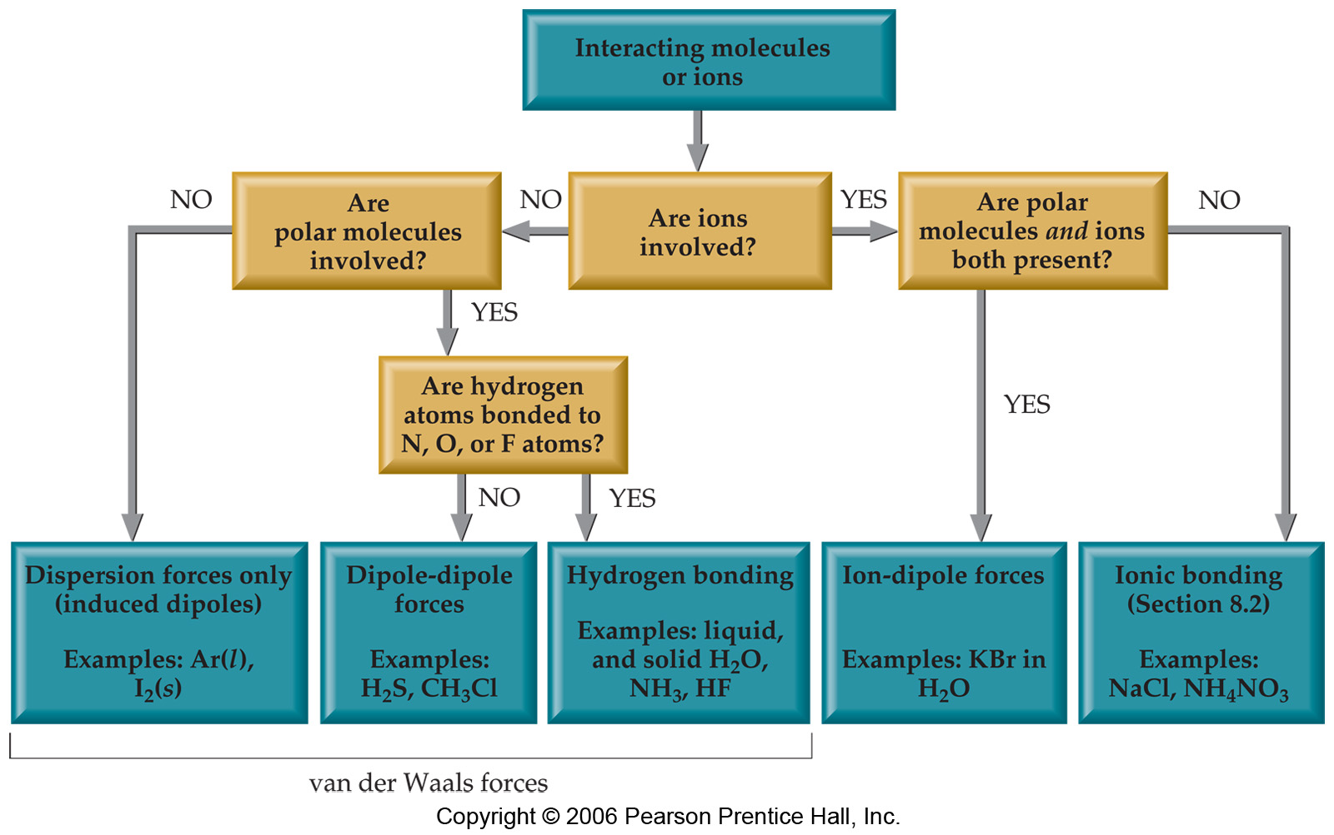
Intermolecular Forces

Slide 39
What type(s) of intermolecular forces exist between the following pairs?
1) HBr and H₂S
2) Cl₂ and CBr₄
3) I₂ and NO₃⁻
4) NH₃ and C₆H₆
Question:
dipole-dipole
ion-dipole
ion-induced dipole
dipole-induced dipole
instantaneous dipole-induced dipole
Hint: First classify the species into three categories:
ionic, polar, or nonpolar.

Slide 40
Strength of Intermolecular Forces
ion-dipole
dipole-dipole
hydrogen bonding
Induced/instantaneous dipole:
  ion-induced dipole
  dipole-induced dipole
  instantaneous dipole-induced dipole
(40-600 kJ/mol)
(5-25 kJ/mol)
X
H
…
X
(10-40 kJ/mol)
(5-15 kJ/mol)
(2-10 kJ/mol)
(0.05-40 kJ/mol)

Slide 41
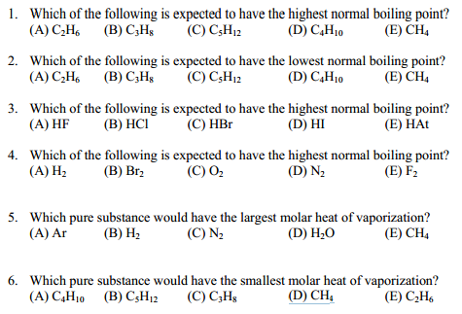
Strength of Intermolecular Forces
Intermolecular Forces general correlate with boiling point.
greater force = higher boiling point

Slide 43
Properties of liquids
Boiling point
Surface Tension
  intermolecular forces at liquid-air interface
Capillary Action
  competition between intermolecular forces
Viscosity
  strength of intermolecular forces

Slide 44
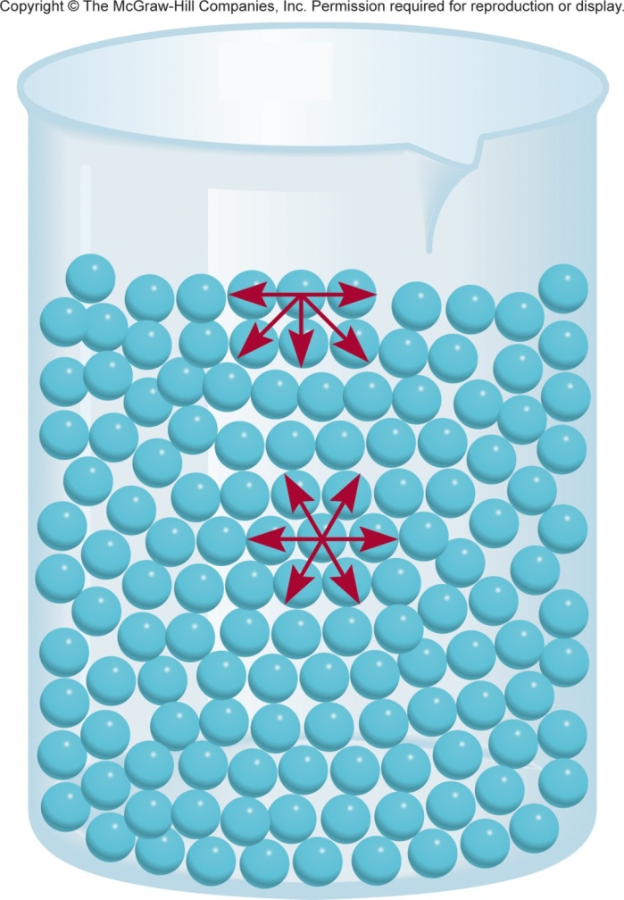
Surface Tension
Surface tension is the amount of energy required to stretch or increase the surface of a liquid by a unit area (N/m).
The surface molecules have higher energy than the interior molecules.
That’s why liquids tend to minimize their surface and form droplets.
Surface tension is a measure of attractive forces acting at the surface of a liquid.
The molecules at the surface are attracted unevenly.

Slide 45






Surface Tension
Water
Mercury
Not just surface tension but still cool.

Slide 46

Surface Tension
Stronger intermolecular forces = greater surface tension.

Slide 47


Surface Tension
propylene glycol mixed with water (+Food coloring)
Manu Prakash and coworkers at
Stanford University
Differences in surface tension dictate mixing.

Slide 48
Properties of liquids
Boiling point
Surface Tension
  intermolecular forces at liquid-air interface
Capillary Action
  competition between intermolecular forces
Viscosity
  strength of intermolecular forces

Slide 49





Capillary Action
Capillary action (sometimes capillarity, capillary motion, or wicking) is the ability of a liquid to flow in narrow spaces without the assistance of, and in opposition to, external forces like gravity.

Slide 50


Forces Involved in the Capillary Action
Cohesive forces are the forces that hold liquids together (intermolecular forces).
Adhesive forces are the forces between a liquid and another surface (intermolecular forces).
Adhesive forces > cohesive forces
Adhesive forces < cohesive forces
Capillary rise.
Capillary fall.

Slide 51


Capillary Action
Water
Concave meniscus
Mercury:
Convex meniscus
adhesive forces > cohesive forces
adhesive forces < cohesive forces

Slide 52


Capillary Action
h = height of the liquid
T = surface tension
Θ = the contact angle
r = the radius
ρ = the density
g = gravity (9.8 m/s²)
Smaller diameter, higher the climb.
Volume (gravity) vs. Surface area (adhesion)

Slide 53
Properties of liquids
Boiling point
Surface Tension
  intermolecular forces at liquid-air interface
Capillary Action
  competition between intermolecular forces
Viscosity
  strength of intermolecular forces

Slide 54

Viscosity
Viscosity is the resistance of a liquid to flow.
    water is less viscous than syrup or honey.
Tthe ease with which molecules can move past each other.
Decreases with increasing temperature.
Viscosity depends on intermolecular forces and on the shape of molecules.
  Liquids with small spherical molecules are less viscous than liquids with long molecules that can become entangled and have high surface area.

Slide 55



Viscosity
Low Viscosity
High Viscosity
Strong intermolecular forces
= higher viscosity

Slide 56


Viscosity
Pitch Drop “Experiment”
Started in 1927
by Professor Thomas Parnell
University of Queensland in Australia
Worlds longest experiment
9th drop fell April 17th, 2014
https://www.youtube.com/watch?v=BZvsrOciU_Q
http://www.thetenthwatch.com/

Slide 57
Properties of liquids
Boiling point
Surface Tension
Capillary Action
Viscosity
Strong intermolecular forces = higher boiling point
Strong intermolecular forces = higher surface tension
Competition between cohesive and adhesive intermolecular forces
Strong intermolecular forces = higher viscosity

